Slide 1
CSSE3113 – Introduction to Software Engineering
Agile Development

Slide 2
Outline
Agile Software Development
Extreme Programming
Scrum
Kanban
DevOps

Slide 3
An Agile Process
Agile means being able to “Deliver quickly. Change quickly. Change often”
Develops software iteratively
Delivers multiple ‘software increments’
Adapts as changes occur

Slide 4
Agile Software Development
Characteristics of Agile Software Development
Small to medium sized teams
changing requirements
changing techniques
Simple design

Slide 5
Agile Methods
These methods
Focus on the code
Are based on an iterative approach to software development
Are intended to deliver working software quickly and evolve this quickly to meet changing requirements.
The aim of agile methods is to reduce overheads in the software process (e.g. by limiting documentation) and to be able to respond quickly to changing requirements without excessive rework.

Slide 6
The Principles Of Agile Methods
Principle | Description
Customer involvement | Customers should be closely involved throughout the development process. Their role is provide and prioritize new system requirements and to evaluate the iterations of the system.
Incremental delivery | The software is developed in increments with the customer specifying the requirements to be included in each increment.
People not process | The skills of the development team should be recognized. Team members should be left to develop their own ways of working.
Adapt change | Expect the system requirements to change and so design the system to accommodate these changes.
Maintain simplicity | Focus on simplicity in both the software being developed and in the development process. Wherever possible, actively work to eliminate complexity from the system.

Slide 7
Agile Methodologies
eXtreme Programming (XP)
Scrum
Kanban
DevOps

Slide 8
Extreme Programming
Perhaps the best-known and most widely used agile method.
New versions may be built several times per day
Increments are delivered to customers every 2 weeks
All tests must be run for every build and the build is only accepted if tests run successfully.

Slide 9
Extreme Programming (XP)
XP Values
Communication(Be together with your customer and fellow programmers, and talk to each other )
Simplicity (Use simple design and programming practices, and simple methods of planning, tracking, and reporting)
Feedback(Test your program and your practices, using feedback to steer the project)

Slide 10
Extreme Programming Core Practices (A)
Principle or practice | Description
Incremental planning | Requirements are recorded on story cards The developers break these stories into development ‘Tasks’.
Small releases | The minimal useful set of functionality that provides business value is developed first. Releases of the system are frequent and incrementally add functionality to the first release.
Simple design | Enough design is carried out to meet the current requirements and no more.
Test-first development | An automated unit test framework is used to write tests for a new piece of functionality before that functionality itself is implemented.
Refactoring | All developers are expected to refactor / restructure the code continuously as soon as possible code improvements are found. This keeps the code simple and maintainable.

Slide 11
Extreme Programming Core Practices (B)
Pair programming | Developers work in pairs, checking each other’s work and providing the support to always do a good job.
Collective ownership | The pairs of developers work on all areas of the system, all the developers take responsibility for all of the code. Anyone can change anything.
Continuous integration | As soon as the work on a task is complete, it is integrated into the whole system. After any such integration, all the unit tests in the system must pass.
Sustainable pace | Large amounts of overtime are not considered acceptable as the net effect is often to reduce code quality and productivity
On-site customer | A representative of the end-user of the system (the customer) should be available full time. In an extreme programming process, the customer is a member of the development team and is responsible for bringing system requirements to the team for implementation.

Slide 12
The Extreme Programming Release Cycle

Slide 13
Example – Story Card For Downloading Document

Slide 14
Task Cards

Slide 15
What is Scrum?
Scrum is light weight, interrelated practices and set of laws to optimize the development environment and reduce organizational overheads.
A Scrum is just like the eight members of the Rugby team, they all are packed together and work as a team. Only one goal has to achieve by the entire team at a single time. [Mike Beedle (2001)]

Slide 16
Scrum in Detail
Scrum Phases
There are three phases in Scrum given below:-
Planning - In planning phase of Scrum model, the requirements are gathered by the customers by scratching a new system
Development Sprints - In this phase of Scrum, the
developers start coding and developing the functions or module in sprints iterations
Closure - In this phase, the final product is released, and documentation is made. Sprint review meeting conduct to check either the goals are achieved or not

Slide 17
Scrum in Detail…..continue
Scrum Roles
Product Owner - Product owner has different responsibilities. Their main responsibility is to define the features of the product backlog. Product backlog is the lists of features which are required by the customer
Scrum Master - Scrum Master is the team lead or project manager of the project. It has close links with product owner. It has responsibility to solve all problems faced by the team members during the life cycle
Team - The team members in Scrum consist of seven members. The number can vary from project to project. The main function of the team is to develop the product. The team complete the different tasks assigned by the product owner.

Slide 18
Scrum in Detail…..continue
Scrum Artifacts
There are three artifacts in Scrum are Product backlog, Sprint Backlog and Burn down Charts.
Product Backlog - In product backlog, product owner prepares a list of customer requirements and then prioritized them with high return of investment. The higher priority function is made first and lower propriety function develops later in development phase.
Sprint Backlog - In sprint backlog, the team of the Scrum is committed to complete all tasks given by the product owner within the time frame. Sprint backlog are maintained by Scrum Master.
Burn Down Chart - In burn down chart sprint progress, release progress and product progress are maintained through graphs. The estimation of the product list is maintained in it. The estimated time are mentioned in the graph to complete the different task. It is maintained by product owner

Slide 19
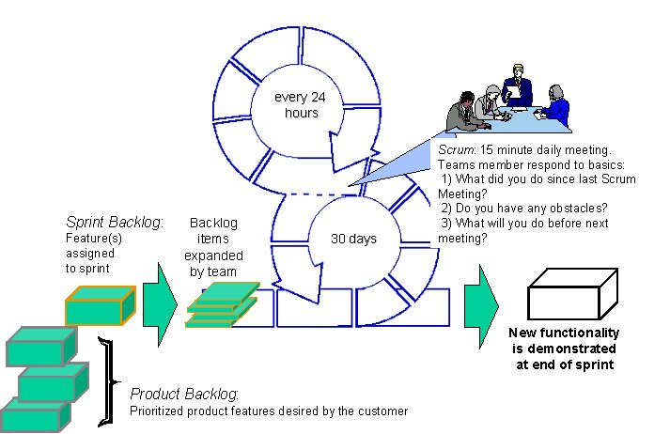
Scrum Process Flow

Slide 20
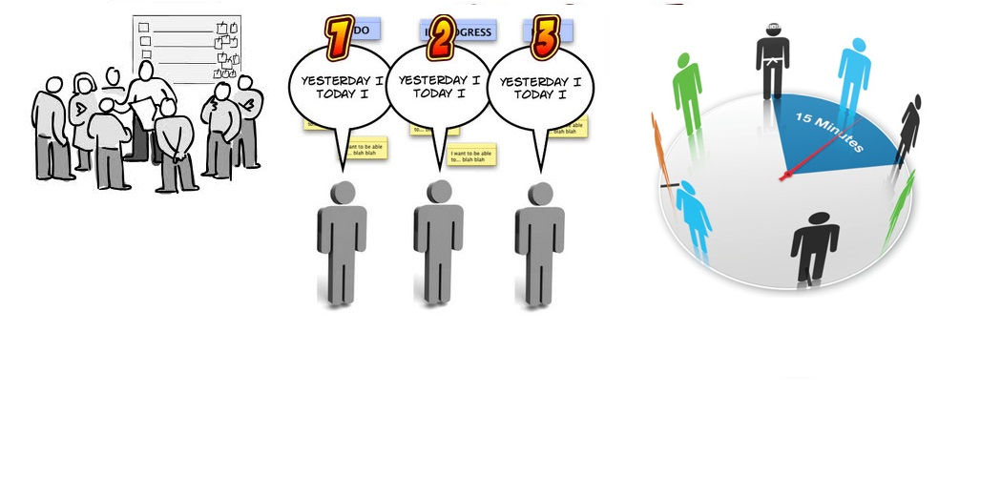
Standup meetings

Slide 21
Scrum
Scrum says that Repeated/Defined problems, solutions, Developers and organizational environment is not entirely possible because developers change from one project to another.
Scrum assumes that the development process is always empirical and not defined.
Scrum says uncertainties are impossible to measure, therefore, looks beyond the repeatable /defined approach

Slide 22
Why Scrum Works
Most of the defined model assumptions are removed
Constant feedback
Focused on “What can be done” instead of “Why it can’t be done”

Slide 23
Advantages
Great emphasis on teamwork
Team learns and contributes throughout the process
Team becomes autonomous and strives for excellence
Rotation of leadership depending on the phase gives a distributed nature of project execution

Slide 24
Advantages (Cont.)
The management team has a pulse on the progress of the team, stepping in whenever required
Creates an open environment and encourages feedback
Evaluation of effort and subsequent rewards are based on the team performance
Reduced need for meetings, authorization and reporting
Iterative model leading to a delivery every 30 days

Slide 25
Disadvantages
Reusability is not considered in Scrum model.
In product backlog, the product owner prioritized the item and business values in terms of most return of investment. This will not be suitable in large scale projects.
Changing requirements is welcome at any stage of the development in Scrum. This will tend to increase the cost of the project and also increase the time.
In Scrum, a daily meeting takes place for 15 minutes. These meetings are not considered to be a good strategy to cope the problems. Basically, it tends to increase the complexity of the project.
Increase feedback by the customer will increase the quality of the product but feedback which comes in later stage of the development will become a big problem. It will be very difficult to change the scope of the project in later stage of the development life cycle.

Slide 26
Kanban
The word Kanban is of Japanese origin and its meaning is linked to a time concept, “just-in-time”.
The Kanban method exists in a board or table (Kanban board), divided into columns, that shows every flow of the software production.
As the development evolves, the information contained in the table changes, and when a new task comes into play, a new “card” is created.
The Kanban method requires communication and transparency so that the members of a team can know exactly at what stage the development is and can see the status of the project at any time.

Slide 27
Kanban
Advantages
Disadvantages
Ability to view all tasks of one project (Completed, In Progress or In Testing, for example);
It is possible to limit the number of running tasks (that is, the amount of work, bearing in mind its resolution or deliverability);
Focus on the duration of a cycle – how long it takes a task to go from backlog to the final stage;
Allows continuous deliveries.
It is possible for members of a team to misinterpret the information show on the Kanban Board, especially when it is revealed as outdated;
Since there are no timeframes in Kanban, you can face time related problems, such as delays, associated with each and every stage.

Slide 28
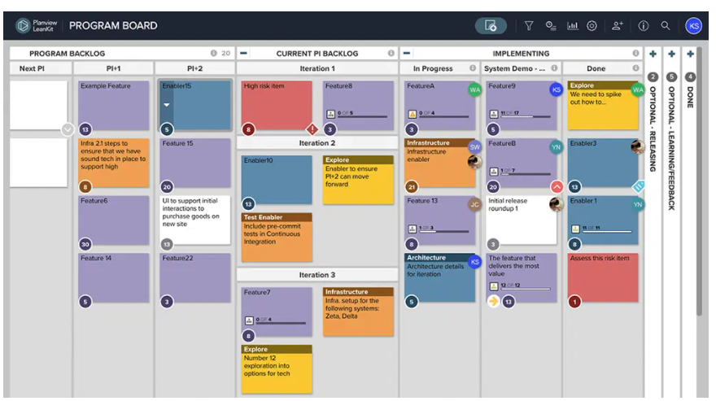

Slide 29
DevOps
DevOps Stages
This approach involves several stages that loop continuously until the desired product exists:-
Continuous Development – Software deliverables are broken down and developed in multiple sprints
Continuous Testing – Automated testing tools are used to help team members test multiple code increments at the same time.
Continuous Integration – The code pieces with new functionality are added to the existing code and checked to ensure there are no errors.
Continuous Deployment – At this stage the integrated code is deployed to the production environment.
Continuous Monitoring – Members in the development team help to improve software quality by monitoring its performance.

Slide 30
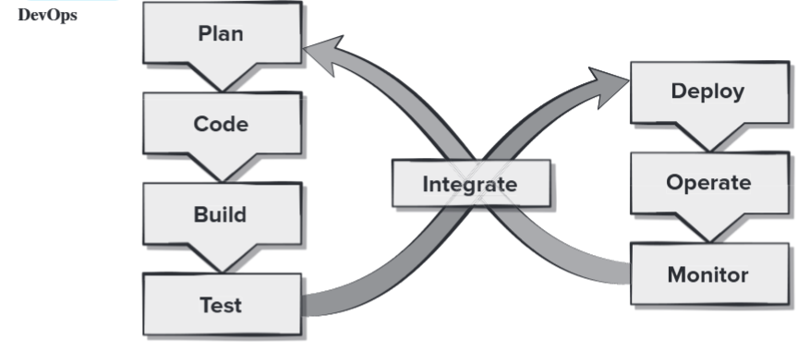
DevOps (Cont.)

Slide 31
DevOps Tools
1. Version Control Systems (VCS)
-GitHub: Web-based hosting service for Git repositories.
2. Continuous Integration and Continuous Deployment (CI/CD)
- Jenkins: Open-source automation server for CI/CD.
3. Configuration Management
- Ansible: Automation tool for configuration management,
application deployment, and task automation.
4. Containerization and Orchestration
- Docker: Platform for developing, shipping, and running
applications in containers.
5. Infrastructure as Code (IaC)
- Terraform: Tool for building, changing, and versioning
infrastructure safely and efficiently.

Slide 32
DevOps Tools (Cont.)
6. Monitoring and Logging
- Prometheus: Open-source monitoring and alerting toolkit.
7. Collaboration and Communication
- Slack: Messaging platform for teams.
8. Artifact Repositories
- Nexus Repository Manager**: Repository manager for binaries
and build artifacts.
9. Security and Compliance
- SonarQube: Platform for continuous inspection of code quality.
10. Cloud Providers
- AWS (Amazon Web Services): Comprehensive cloud computing
platform.
11. Testing Tools
- Selenium: Open-source tool for automating web browsers.
12. Database Management
- MySQL: Open-source relational database management system.

Slide 33
DevOps Tools (Cont.)
13. Service Mesh
- Istio: Open-source service mesh for microservices.
14. Package Managers
- Maven: Build automation tool used primarily for Java
15. Scripting and Automation
- Bash: Unix shell and command language.
16. Virtualization
- VMware: Virtualization and cloud computing software.
17. Performance Testing
- JMeter: Open-source tool for performance testing and load
testing.
18. Incident Management
- PagerDuty: Incident management platform.
19. Documentation
- Swagger: Framework for API documentation.
20. Backup and Recovery
- Duplicati: Free backup software.

Slide 34
Discussion Question
Suggest a suitable process model.
Mughal brothers Pvt Ltd is the distributor of the Qarshi products in Pakistan. This company wants to automate the sale purchase and inventory system. Previously the company has no experience of information technology. They have no idea of what will be the size, cost and duration of the project.

